Slide 1

VALLURUPALLI NAGESWARA RAO VIGNANA JYOTHI INSTITUTE OF ENGINEERING AND TECHNOLOGY
Department of Computer Science and Engineering
Dimensionality Reduction techniques
MACHINE LEARNING
Dr. Kriti Ohri
Assistant Professor
Department of Computer Science and Engineering

Slide 2
Curse of Dimensionality
Dimensionality Reduction techniques:
1. Feature Selection
2. Feature Extraction

Slide 3
What is dimensions
The number of input variables or features for a dataset is referred to as its dimensionality. ... Large numbers of input features can cause poor performance for machine learning algorithms. Dimensionality reduction is a general field of study concerned with reducing the number of input features.

Slide 4
Curse of Dimensionality
Increasing the number of features will not always improve classification accuracy.
In practice, the inclusion of more features might actually lead to worse performance.
k=3
3¹ bins
3² bins
k: number of bins per feature
3³ bins

Slide 5
In instance based learning (KNN) , we have seen that in instance based learning given the test data instance we have to find out the nearby instances for this we need a distance function. This distance function is computed in term of the features. If the number of features is large there is a problem, because the distance that you get may not be representative of the actual distance. So, this is a reason why feature reduction becomes important.

Slide 6
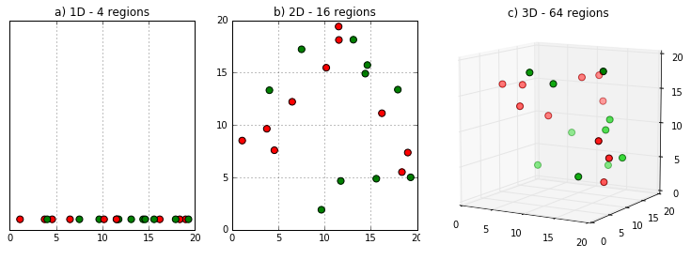
Dimensional Space from simple to complex

Slide 7
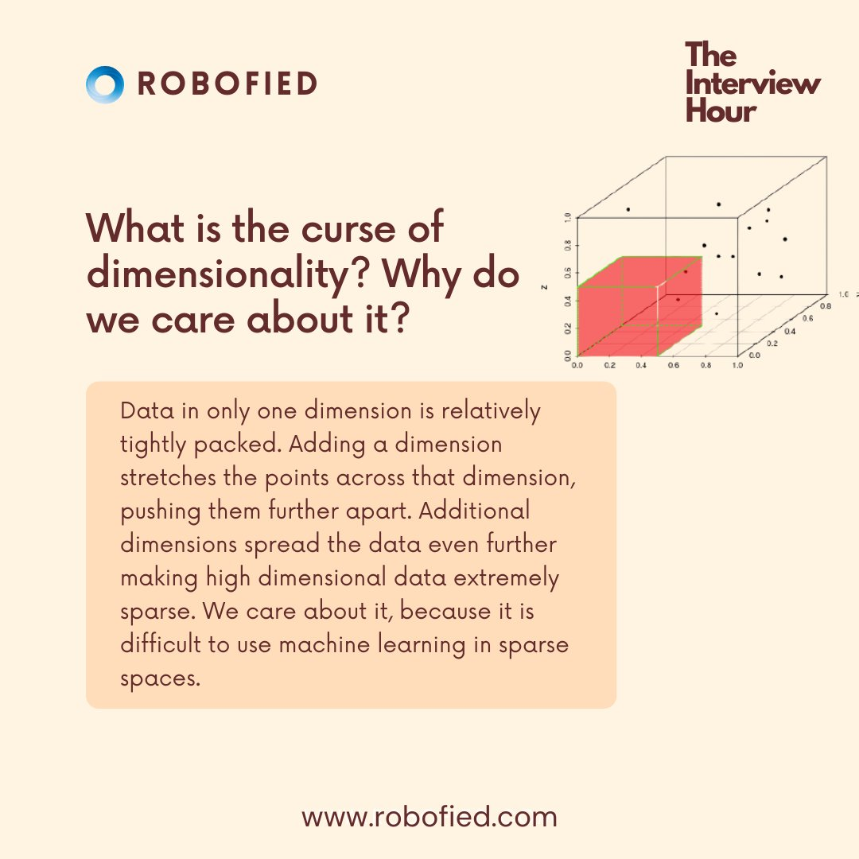

Slide 8
Feature selection is the key influence factor for building accurate machine learning models. Let’s say for any given dataset the machine learning model learns the mapping between the input features and the target variable.
In machine learning, many factors affect the performance of a model, and they include:
Algorithm choice
The features used to train the model,
Parameters used in the algorithm
Quality of the dataset
Therefore, it is beneficial to discard the conflicting and unnecessary features from our dataset by the process known as feature selection methods or feature selection techniques.

Slide 9
Machine Learning in general works wonders when the dataset provided for training the machine is large and concise. Usually having a good amount of data lets us build a better predictive model since we have more data to train the machine with. However, using a large data set has its own pitfalls. The biggest pitfall is the curse of dimensionality.
It turns out that in large dimensional datasets, there might be lots of inconsistencies in the features or lots of redundant features in the dataset, which will only increase the computation time and make data processing and EDA more convoluted.
To get rid of the curse of dimensionality, a process called dimensionality reduction was introduced. Dimensionality reduction techniques can be used to filter only a limited number of significant features needed for training and this is where PCA comes in.

Slide 10
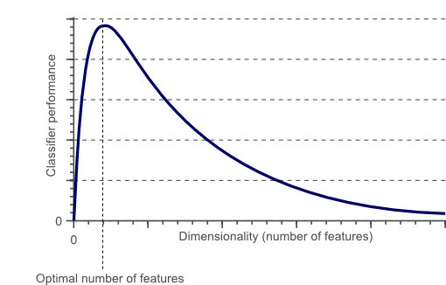
Curse of Dimensionality
As you keep the number of training examples fixed and the training set is not extremely large then typically what may happen is that, when you increase the number of features initially the classifier performance may go up and then the classifier performance may be degradation.

Slide 11
Why all features may not be important in our model
Features can be irrelevant and can induce noise.
Some features are redundant. If you have a fixed number of training examples and redundant features which do not contribute additional information they may lead to degradation in performance of the learning algorithm.
So, these things contribute to phenomena which we call the curse of dimensionality. When you have too many features, too many dimensions this will lead to the degradation of the learning algorithm, more computational time and this phenomena is called the Curse of Dimensionality. To overcome this curse of dimensionality we should do dimensionality reduction.

Slide 12
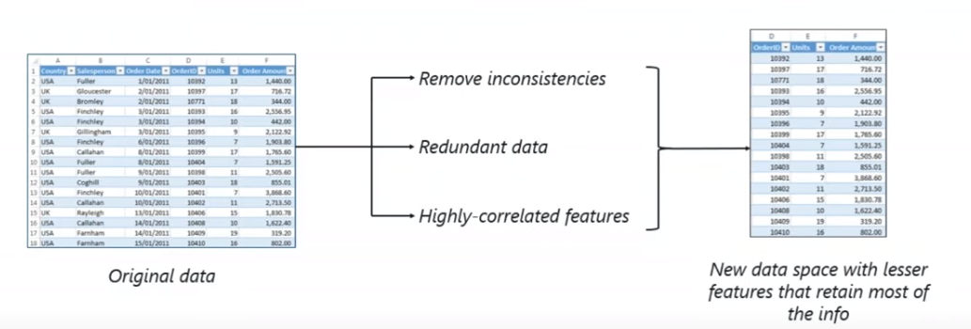
Reducing the dimensions

Slide 13
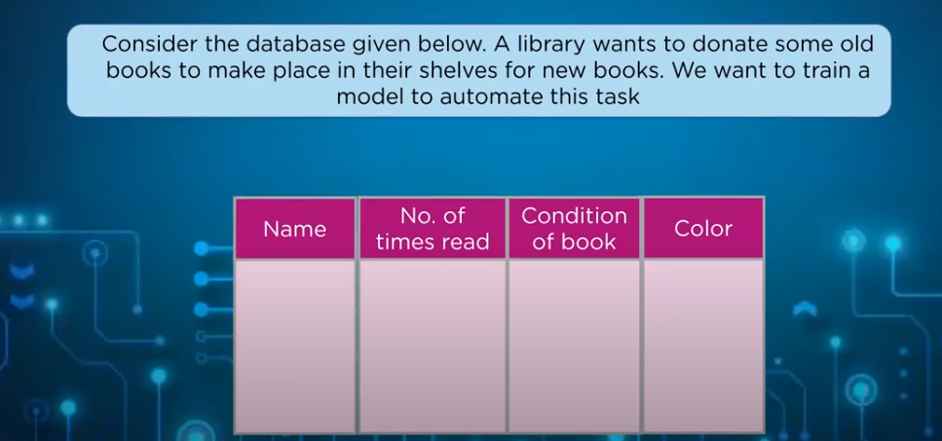
Predict if a library book can be donated

Slide 14
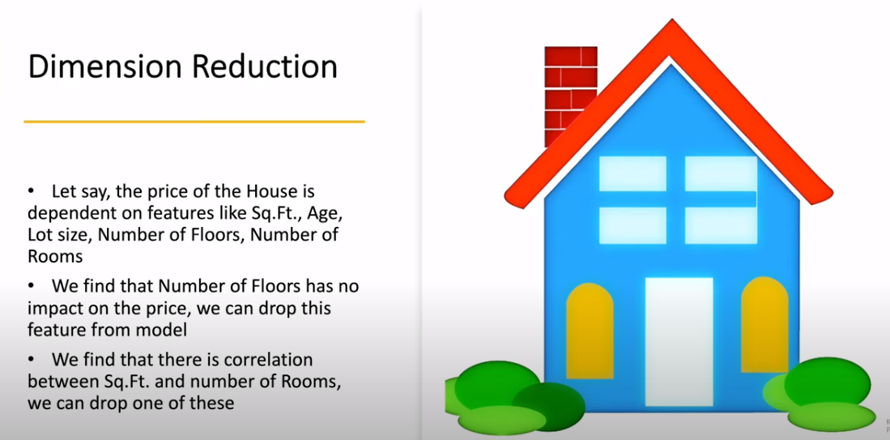

Slide 15
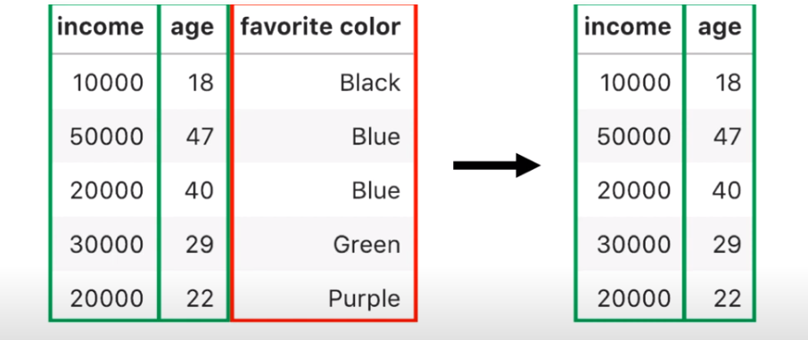
Predicting if you will give loan to a customer or not
Here favorite color is irrelevant for predicting the loan

Slide 16
Dimensionality reduction
Dimensionality reduction transforms the features into a lower dimension. It reduces the number of attributes by creating new combinations of attributes.

Slide 17
Advantages of reducing dimensionality
The dataset will be less complex.
Requires less disk space.
Require less computation time
Have low chance of model overfitting.

Slide 18
Dimensionality Reduction
What is the objective?
  Choose an optimum set of features of lower dimensionality to improve classification accuracy.
  Different methods can be used to reduce dimensionality:
  Feature selection
  Feature extraction

Slide 19
To overcome curse of dimensionality
Feature Selection
Feature Extraction
1. Wrapper methods
3. Embedded
1. PCA
Forward Selection
Backward Selection
2. Filter methods
2. LDA
Univariate feature selection
Multivariate feature selection

Slide 20
Feature Selection types
Supervised Feature Selection Methods
1. Wrapper methods
3. Embedded
2. Filter methods
Univariate filter methods
Multivariate filter methods.

Slide 21
What is feature selection
The method of reducing the number of input variables during the development of a predictive model.”
OR
“Feature selection is a process of selection of a subset of relevant features or variables from a set of all features, used in the process of model building.”
Other names of feature selection are variable selection or attribute selection.
It is possible to select those characteristic variables or features in our data that are most useful for building accurate models. In feature selection what we do is that, given an initial set of features we find the sub set from the set of features so that it optimizes certain criteria.
.

Slide 22
Benefits of Feature Selection
Having irrelevant features in your data can decrease the accuracy of many models, especially linear algorithms like linear and logistic regression , KNN
The benefits of performing feature selection before modeling the model are as under:
Reduction in Model Overfitting: Less redundant data implies less opportunity to make noise based decisions.
Improvement in Accuracy: Less misleading and misguiding data implies improvement in modeling accuracy.
Reduction in Training Time: Fewer data implies that algorithms train at a faster rate.

Slide 23
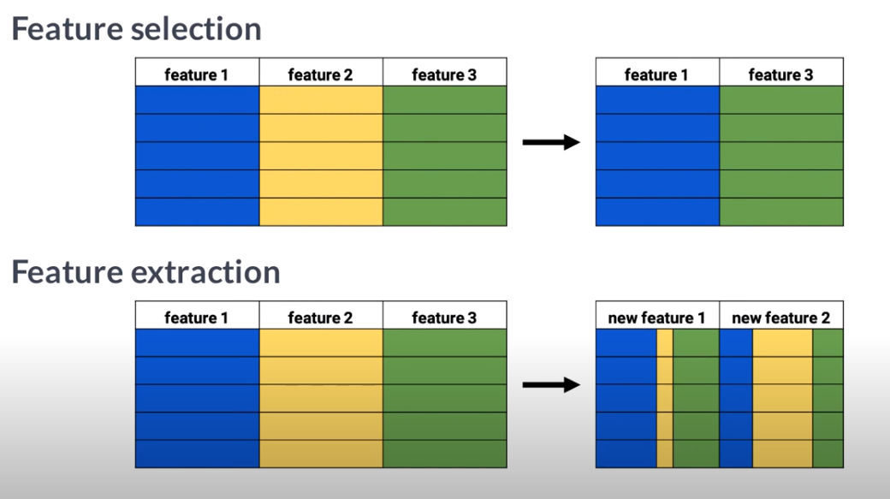
Feature selection- selecting the relevant variables and leaving the rest.
Feature extraction- making the representation of multiple variables as one.

Slide 24
Why is Feature Selection Important?
Irrelevant and misleading data features can negatively impact the performance of our machine learning model. That is why feature selection and data cleaning should be the first step of our model designing.
These feature selection methods reduce the number of input variables/features to those that are considered to be useful in the prediction of the target.
So, the primary focus of feature selection is to:
Remove non-informative or redundant predictors from our machine learning model.”
Some predictive modeling problems contain a large number of variables that require a large amount of system memory, and therefore, retard the development and training of the models.
The importance of feature selection in building a machine learning model is:
It improves the accuracy with which the model is accurately able to predict the target variable of the unseen dataset.
It reduces the computational cost of the model.
It improves the understandability of the model by removing the unnecessary features so that it becomes more interpretable.

Slide 25
Feature Selection types
Supervised Feature Selection Methods
3. Embedded methods
1. Wrappers methods
2. Filters
Univariate filter methods
Multivariate filter methods.

Slide 26
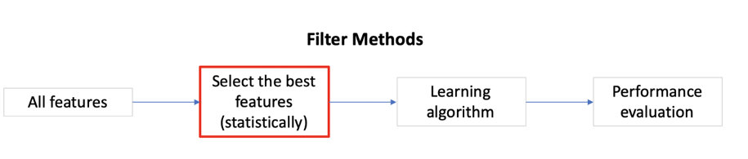
Filter Feature Selection Methods
They are Learner independent
In the filter method the search algorithm comes up with a feature subset that is evaluated for information context and based on that search algorithm proceeds and finally we get final features subset.
In filter methods we look at only the input and we select the subset which has the most information.
The filter feature selection methods make use of statistical techniques to predict the relationship between each independent input variable and the output (target) variable. Which assigns scores for each feature.
Filter methods select features from a dataset independently for any machine learning algorithm. These methods rely only on the characteristics of these variables, so features are filtered out of the data before learning begins.
These methods are powerful and simple and help to quickly remove features— and they are generally the first step in any feature selection pipeline

Slide 27
Filter Feature Selection Methods
Filter techniques assess the relevance of features by looking at the intrinsic properties of the data. In filter criteria, all the features are scored and ranked based on certain statistical criteria. The features with the highest ranking values are selected and the low scoring features are removed.
Filter methods are fast and independent of the classifier but ignore the feature dependencies and also ignores the interaction with the classifier.

Slide 28
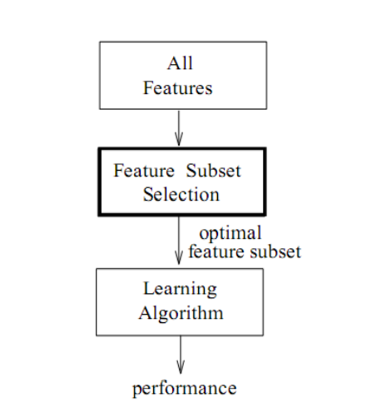
Working of Filter Method

Slide 29
filtering criteria:
Information Gain to find relevant features
Proxies of Information Gain
Variance
Retain Independent/Non Redundant Features: removing the redundant features
Exclude the features which has many missing values
We can use Correlation coefficient to find out which features to retain, the features which have strong relationship with target variables can be retained.
Use Chi square test
Remove Constant Features that show single values in all the observations in the dataset. These features provide no information that allows ML models to predict the target

Slide 30
Information Gain
Information gain: This criterion measures the worth of a feature by measuring the information gain with respect to the class. You could in fact have your search algorithm just be a decision tree, and pass the nodes used in the DTree to your learner as your reduced features. So that is like using the inductive bias of DTrees to choose features, then passing it on to your other learner (kNN) with some other bias. This is particularly helpful when this other learner (like NN or kNN) suffers from the curse of dimensionality.

Slide 31
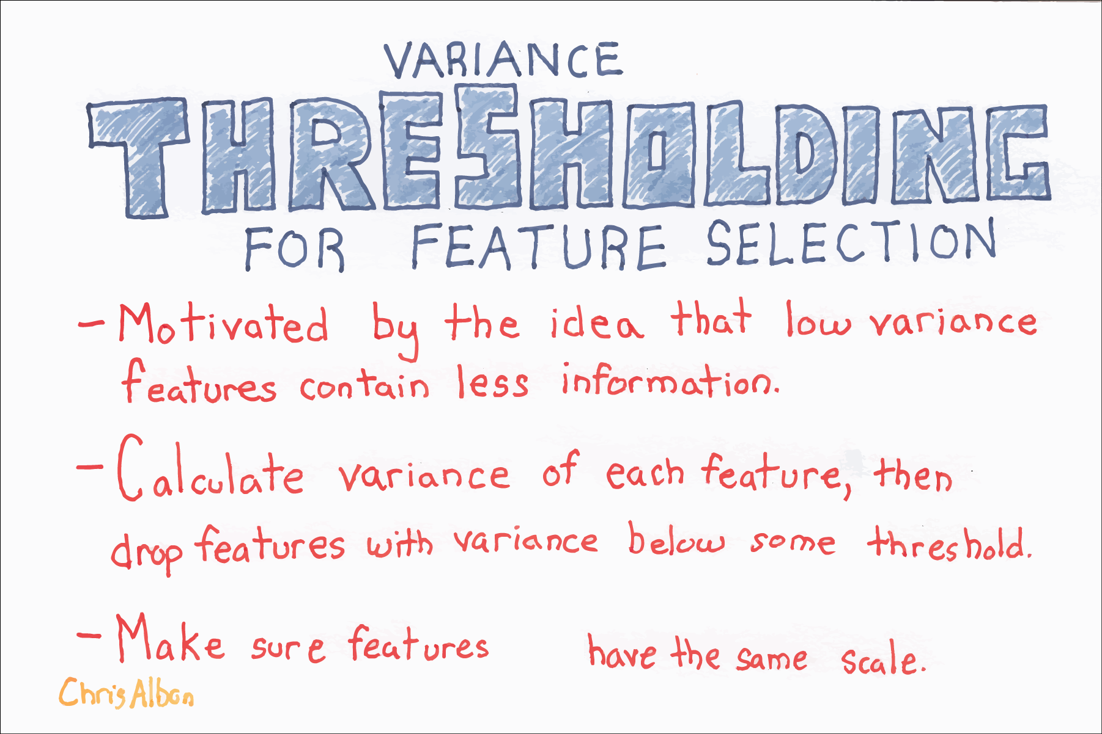
Variance
Another filter method of feature reduction is variance thresholding. The variance of a feature determines how much predictive power it contains. The lower the variance is, the less information contained in the feature, and the less value it has in predicting the response variable.

Slide 32
Low Variance filter
The process flow of this technique is as under:
The variance of all the attributes in a dataset is compared.
The attributes having sufficiently low variance are discarded.
The attributes that do not possess much variance assume a constant value, thus having no contribution to the model’s predictability.

Slide 33
Correlation
Correlation is defined as a measure of the linear relationship between two quantitative variables, like height and weight. You could also define correlation is a measure of how strongly one variable depends on another.
A high correlation is often a useful property—if two variables are highly correlated, we can predict one from the other. Therefore, we generally look for features that are highly correlated with the target, especially for linear machine learning models.
However, if two variables are highly correlated among themselves, they provide redundant information in regards to the target. Essentially, we can make an accurate prediction on the target with just one of the redundant variables.
In these cases, the second variable doesn’t add additional information, so removing it can help to reduce the dimensionality and also the added noise.
There are a number of methods to measure the correlation between variables—let’s explore the most widely used ones.

Slide 34
Pearson correlation coefficient- This is a popular measure we use frequently in machine learning. It’s used to summarize the strength of the linear relationship between two data variables, which can vary between 1 and -1:
1 means a positive correlation: the values of one variable increase as the values of another increase.
-1 means a negative correlation: the values of one variable decrease as the values of another increase.
0 means no linear correlation between the two variables.

Slide 35
High Correlation filter
In this technique, the steps are as under:
The pairwise correlation between attributes is determined.
One of the attributes in the pair that has a significantly high correlation is eliminated and the other retained.
In the eliminated attribute, the variability is captured through the retained attribute.

Slide 36
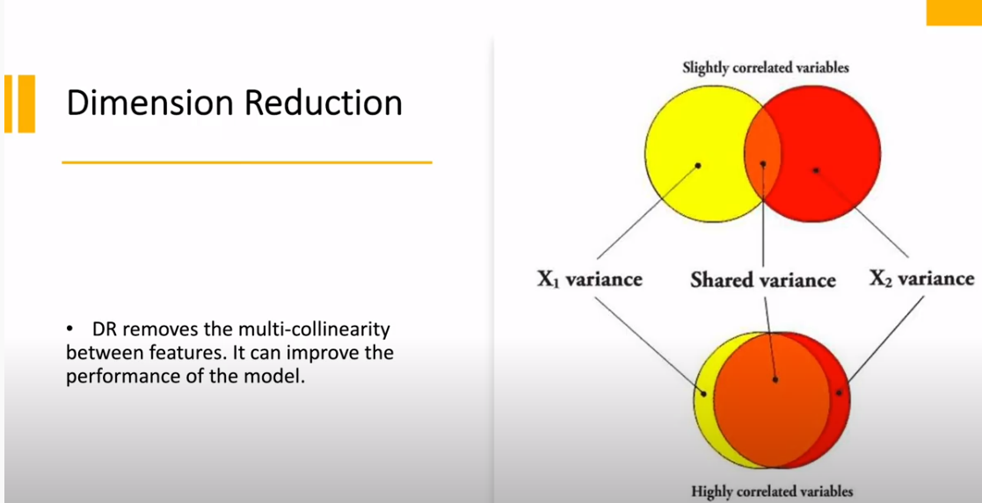
Remove the features that are highly correlated with each other

Slide 37
Chi-squared Score
This is another statistical method that’s commonly used for testing relationships between categorical variables.
Therefore, it’s suited for categorical variables and binary targets only, and the variables should be non-negative and typically boolean, frequencies, or counts.
What it does is simply compare the observed distribution between various features in the dataset and the target variable.

Slide 38
In feature selection, we aim to select the features which are highly dependent on the response.
When two features are independent, the observed count is close to the expected count, thus we will have smaller Chi-Square value. So high Chi-Square value indicates that the hypothesis of independence is incorrect. In simple words, higher the Chi-Square value the feature is more dependent on the response and it can be selected for model training.

Slide 39
The filter methods evaluate the significance of the feature variables only based on their inherent characteristics without the incorporation of any learning algorithm.
These methods are computationally inexpensive and faster than the wrapper methods.
The filter methods may provide worse results than wrapper methods if the data is insufficient to model the statistical correlation between the feature variables.
Unlike wrapper methods, the filter methods are not subjected to overfitting. They are used extensively on high dimensional data.

Slide 40
Filter Methods
Univariate filter methods
Multivariate filter methods

Slide 41
Univariate filter methods
Univariate filter methods evaluate and rank a single feature according to certain criteria.
They treat each feature individually and independently of the feature space.
It ranks features according to certain criteria.
Then select the highest ranking features according to those criteria.
One problem that can occur with univariate methods is they may select a redundant variable, as they don’t take into consideration the relationship between features.
Eg. Information gain, Chi-squared Score, p value, fisher score, variance of the feature.

Slide 42
The univariate filter methods are the type of methods where individual features are ranked according to specific criteria. The top N features are then selected. Different types of ranking criteria are used for univariate filter methods, for example fisher score, mutual information, and variance of the feature.
One of the major disadvantage of univariate filter methods is that they may select redundant features because the relationship between individual features is not taken into account while making decisions. Univariate filter methods are ideal for removing features from the data.

Slide 43
Multivariate filter methods
Multivariate filter methods, on the other hand, evaluate the entire feature space. They take into account features in relation to other ones in the dataset.
Multivariate filter methods are capable of removing redundant features from the data since they take the mutual relationship between the features into account. Multivariate filter methods can be used to remove duplicate and correlated features from the data.

Slide 44
Advantages of filter methods
Selected features can be used in any machine learning algorithm
They’re computationally inexpensive—you can process thousands of features in a matter of seconds.
Filter methods are very good for eliminating irrelevant, redundant, constant, duplicated, and correlated features.
They are not subjected to overfitting

Slide 45
Disadvantages of filter methods
The common disadvantage of filter methods is that they ignore the interaction with the classifier and each feature is considered independently thus ignoring feature dependencies
In addition, it is not clear how to determine the threshold point for rankings to select only the required features and exclude noise.

Slide 46
Wrapper Method
In wrapper methods, the feature selection process is based on a specific machine learning algorithm that we are trying to fit on a given dataset.
It follows a greedy search approach by evaluating all the possible combinations of features against the evaluation criterion. The evaluation criterion is simply the performance measure which depends on the type of problem, for e.g. For regression evaluation criterion can be p-values, R-squared, Adjusted R-squared, similarly for classification the evaluation criterion can be accuracy, precision, recall, f1-score, etc. Finally, it selects the combination of features that gives the optimal results for the specified machine learning algorithm.

Slide 47
Wrapper Method
It is leaner depended.
In wrapper methods we train using the selected subset and we estimates the error on the validation set.
In the wrapper based method the search algorithm output a sub features subset which is again used with the machine learning algorithm and the prediction accuracy is obtained which is fed to the search algorithm. After this whole module is completed you have a feature subset which is used by your machine learning algorithm.
In supervised methods also called the Wrapper methods, we evaluate the feature subset by using it on a learning algorithm. These are called supervised methods or wrapper methods.
Now, as a features subset can be evaluated by two methods in supervise methods or wrapper methods we train using the selected subset and we estimates the error on the validation set.

Slide 48
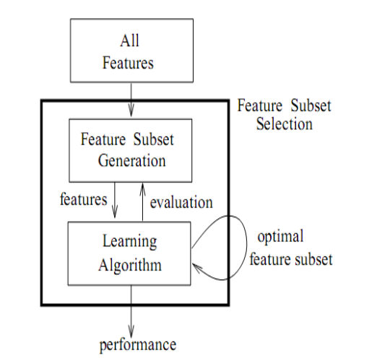
Working of Wrapper method

Slide 49
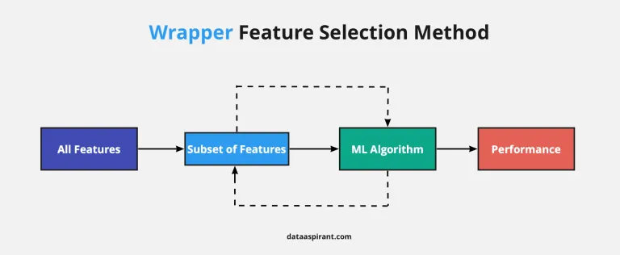
Take the training dataset.
Select the subset of features
Evaluating the performance of classifier on the subset.
Re-iterate
Select the subset that has the highest performance on the dataset.

Slide 50
Types of Wrapper methods
Forward selection
Backward selection

Slide 51
Forward selection
You start with empty feature set and then you add features one by one. So you try each of the remaining features, and for each of them you estimate the accuracy. You estimate the classification or regression error for adding each specific feature. And you select the feature that gives maximum improvement. To find which feature gives maximum improvement you can use the validation set and not the training set. You can stop when there is no significant improvement.

Slide 52
Forward selection
Forward stepwise selection (or forward selection) is a variable selection method which:
Begins with a model that contains no variables (called the Null Model)
Then starts adding the most significant variables one after the other
Until a pre-specified stopping rule is reached or until all the variables under consideration are included in the model or performance gains are not significant.

Slide 53
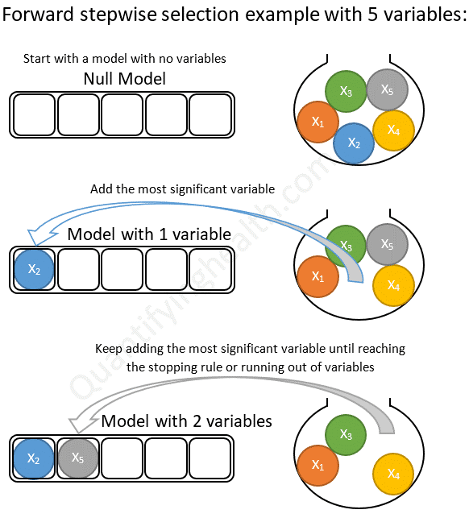

Slide 54
Forward Stepwise selection initially starts with null model.i.e. starts with on variable in the model.
Then we add predictors (Features) one at Time and choose the best model among the bests of each k based on RSS, p value, or adjusted R square.
In this method once the predictor is selected it never drops in second step.

Slide 55
In order to fully understand how forward selection works, we need to know:
How to determine the most significant variable at each step
How to choose a stopping rule

Slide 56
1. Determine the most significant variable to add at each step
The most significant variable can be chosen so that, when added to the model:
It has the smallest p-value, or
It provides the highest increase in R², or
It provides the highest drop in model RSS (Residuals Sum of Squares) compared to other predictors under consideration.

Slide 57
2. Choose a stopping rule
The stopping rule is satisfied when all remaining variables to consider have a p-value larger than some threshold if added to the model.
When we reach this state, forward selection will terminate and return a model that only contains variables with p-values < threshold

Slide 58
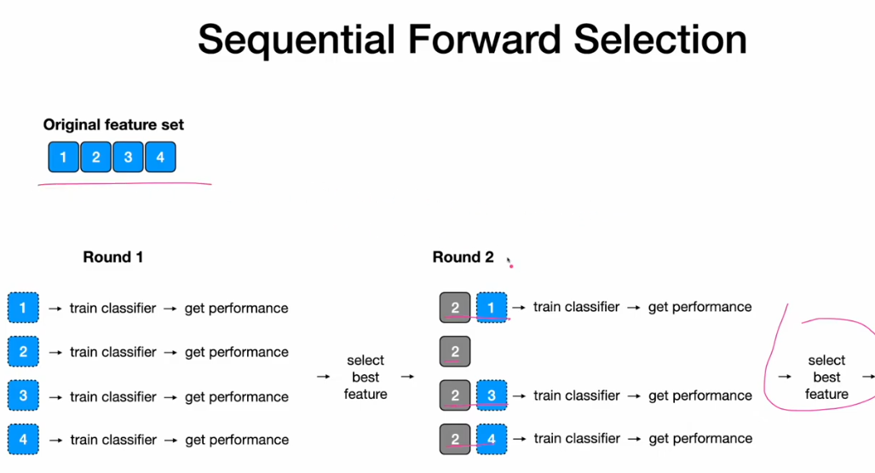

Slide 59
Backward selection
In backward search what should you start with? In backward search you start with the full feature set. Then you try removing features from the features that you have. You find that feature whose removal gives rise to maximum improvement in performance. You try removing drop the feature. You drop the feature with the smallest improvement or with smallest impact on error. So, this is a similar algorithm for backward search to find a features subset.

Slide 60
Backward selection
Backward stepwise selection (or backward elimination) is a variable selection method which:
Begins with a model that contains all variables under consideration (called the Full Model)
Then starts removing the least significant variables one after the other
Until a pre-specified stopping rule is reached

Slide 61
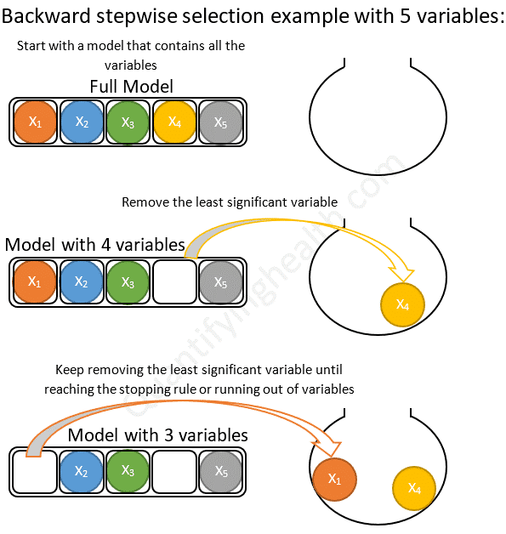

Slide 62
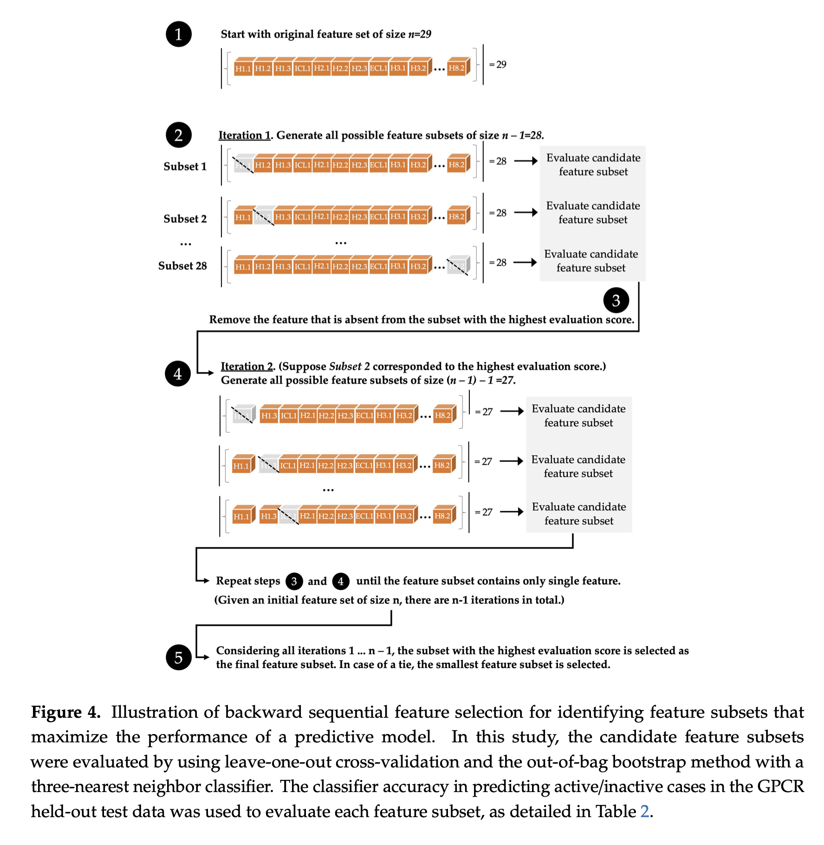

Slide 63
Backward selection works in the opposite direction in that it eliminates features. Because they are not run on every combination of features they are orders of magnitude less computationally intensive than straight subset selection.
Basically, it is opposite of Forward Stepwise selection. it starts with all Predictors and then drop one predictor at time and then select the best model.
Also, computational power is very similar to Forward Selection.

Slide 64
Like we did with forward selection, in order to understand how backward elimination works, we will need discuss how to determine:
The least significant variable at each step
The stopping rule

Slide 65
Determine the least significant variable to remove at each step
The least significant variable is a variable that:
Has the highest p-value in the model, or
Its elimination from the model causes the lowest drop in R2 value.

Slide 66
2 Choose a stopping rule
The stopping rule is satisfied when all remaining variables in the model have a p-value smaller than some pre-specified threshold.
When we reach this state, backward elimination will terminate and return the current step’s model.

Slide 67
Where forward stepwise is better
Unlike backward elimination, forward stepwise selection can be applied in settings where the number of variables under consideration is larger than the sample size!
This is because forward selection starts with a null model (with no predictors) and proceeds to add variables one at a time, and so unlike backward selection, it DOES NOT have to consider the full model (which includes all the predictors).

Slide 68
Where backward stepwise is better
Starting with the full model has the advantage of considering the effects of all variables simultaneously.
This is especially important in case of collinearity (when variables in a model are correlated which each other) because backward stepwise may be forced to keep them all in the model unlike forward selection where none of them might be entered

Slide 69
BOTTOM LINE:
Unless the number of candidate variables > sample size (or number of events), use a backward stepwise approach.

Slide 70
Advantages of Wrapper methods
Simple
Interacts with classifier
Models feature dependencies
Good classification accuracy

Slide 71
Drawbacks of Wrapper methods
The wrapper methods are computationally expensive.
Classifier or model dependent selection
Risk of overfitting

Slide 72
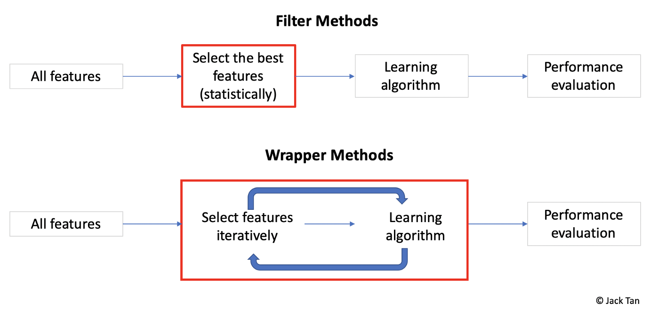

Slide 73
Embedded or Intrinsic Feature Selection Methods
The machine learning models that have feature selection naturally incorporated as part of learning the model are termed as embedded or intrinsic feature selection methods.
Built-in feature selection is incorporated in some of the models, which means that the model includes the predictors that help in maximizing accuracy.
In this scenario, the machine learning model chooses the best representation of the data.

Slide 74
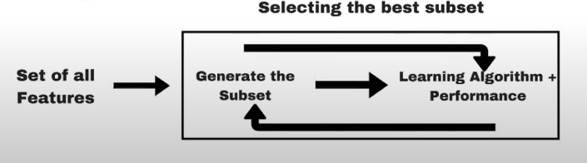
Embedded method

Slide 75
The examples of the algorithms making use of embedded methods are penalized regression models such as
Lasso regression,
Ridge Regression,
Decision trees Algorithm,
Random Forest Algorithm

Slide 76
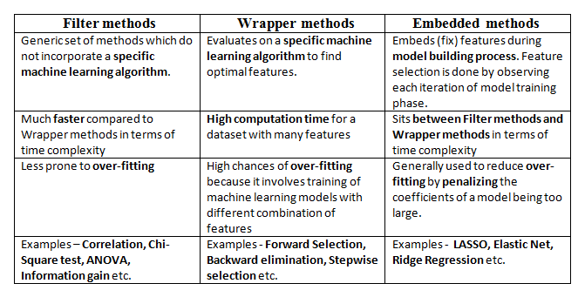
Difference between various feature selection methods

